Slide 1
Foresight Community Brainstorm
Zarrar Khan, Taryn Waite,
Hassan Niazi, Mengqi Zhao, Chris Vernon

Slide 2
Agenda
Introduction
Motivation
Scope
Design
Architecture
Open Ideas

Slide 3
Introduction

Slide 4
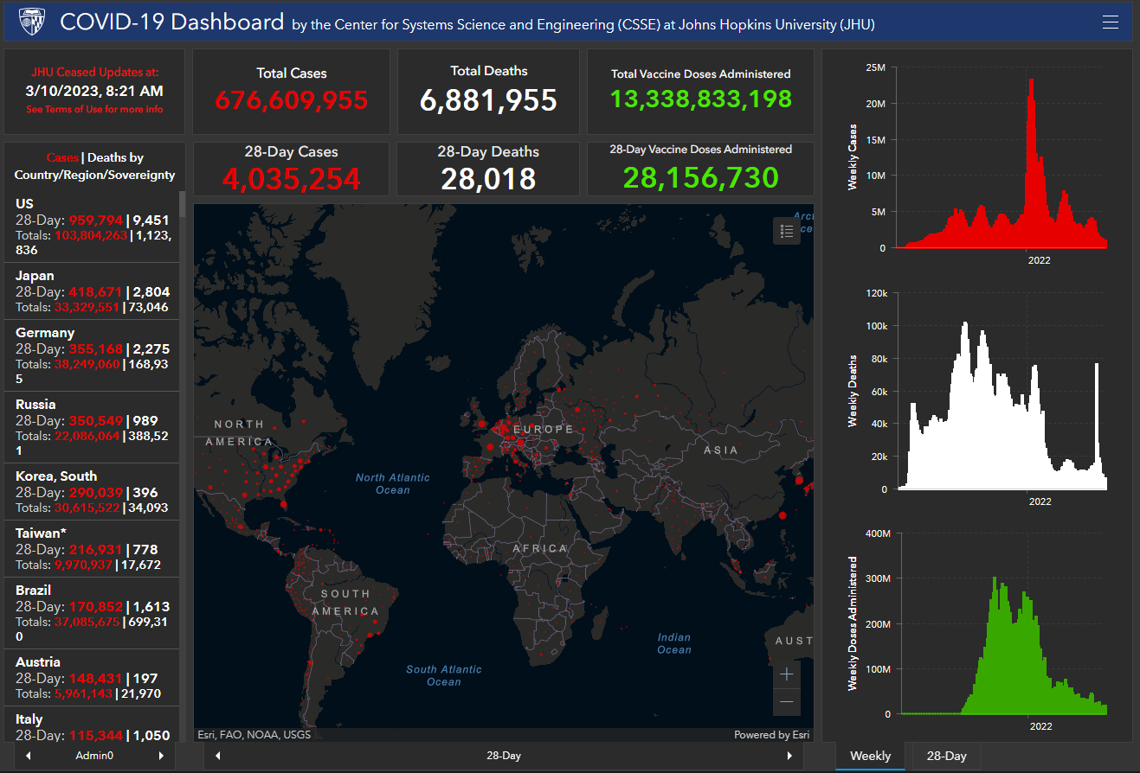
Introduction - Dashboarding
What is a dashboard?
Live visual interface that displays key data and metrics
Linked to a database
Provides a snapshot of important information in real-time or near-real-time
Enables quick identification of areas of concern and trends
Helps inform decision-making and drive action.
https://coronavirus.jhu.edu/map.html

Slide 5

Introduction – Slido Survey
Join at
www.Slido.com
#4138 202

Slide 6


If you weren't human what would you be?
ⓘ Start presenting to display the poll results on this slide.

Slide 7
Motivation

Slide 8
Motivation: What do you think are some benefits of having a dashboard?
ⓘ Start presenting to display the poll results on this slide.

Slide 9
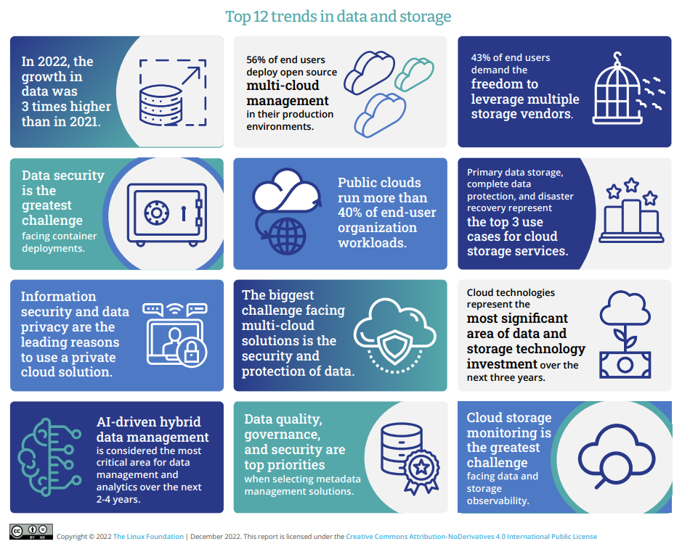










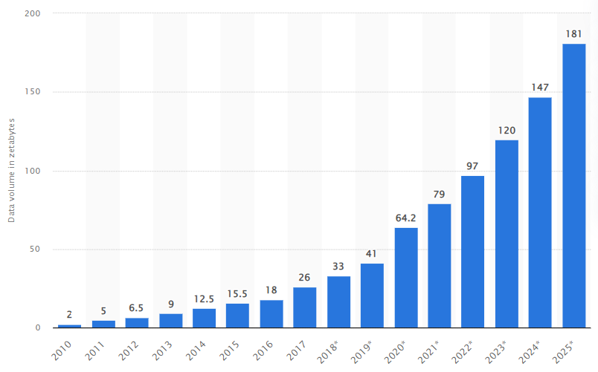











Motivation – Need
Link how these two things could be central to JGCRI products: Data to Information. Research to Recognition
Join at www.Slido.com #4138 202
Data to Story
Tracking Indicators & Trends
Storytelling
Complex Data
Growth of Data & Complexity
Accessible Insights
Visibility
Institutional Hive-Mind
Avoid Redundancy
Research to Recognition
Notes:
Dashboards are useful tools for visualizing data and information in a concise and meaningful way. They are used to present a quick and easy-to-understand overview of key metrics and indicators, which allows users to make informed decisions based on the data.
Data – growing projects, runs, products, data. In https://www.statista.com/statistics/871513/worldwide-data-created/. According to IBM in 2013, 90% of the data was produced in last two years. Over next two years till 2025 we would double our data production (181) compared to today (97). Indicators – with this huge influx of big data keeping track of key indicators and trends becomes difficult. Model changes, new studies come in, Story – without all this story telling becomes difficult.
First three things I have talked about speaks to the importance of going from data to information to story. We all do that in our daily tasks, products, and papers.
But I want you to take a pause and think of one product that we as an institution use to present that information to the world. Papers don’t count. And Zarrar’s metarepos don’t count.
Accessible -
Big data facts: How much data in Zettabytes do we produce? What is the rate of change of data production since 2020?
PNNL's data and dashboard efforts: What is the storage capacity of PNNL's deception cluster? MSD-live. Climate dashboard
What is difference in the size of a db from gcamv5 run vs gcamv6 run?

Slide 10
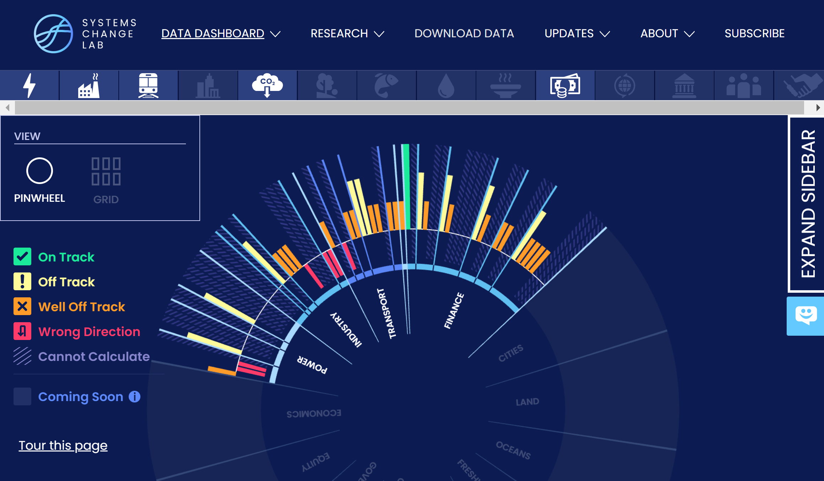
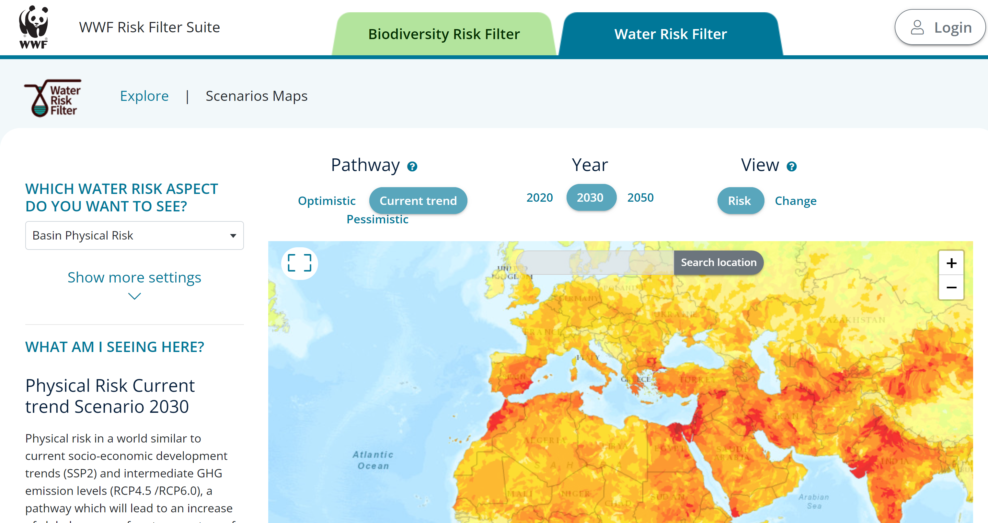
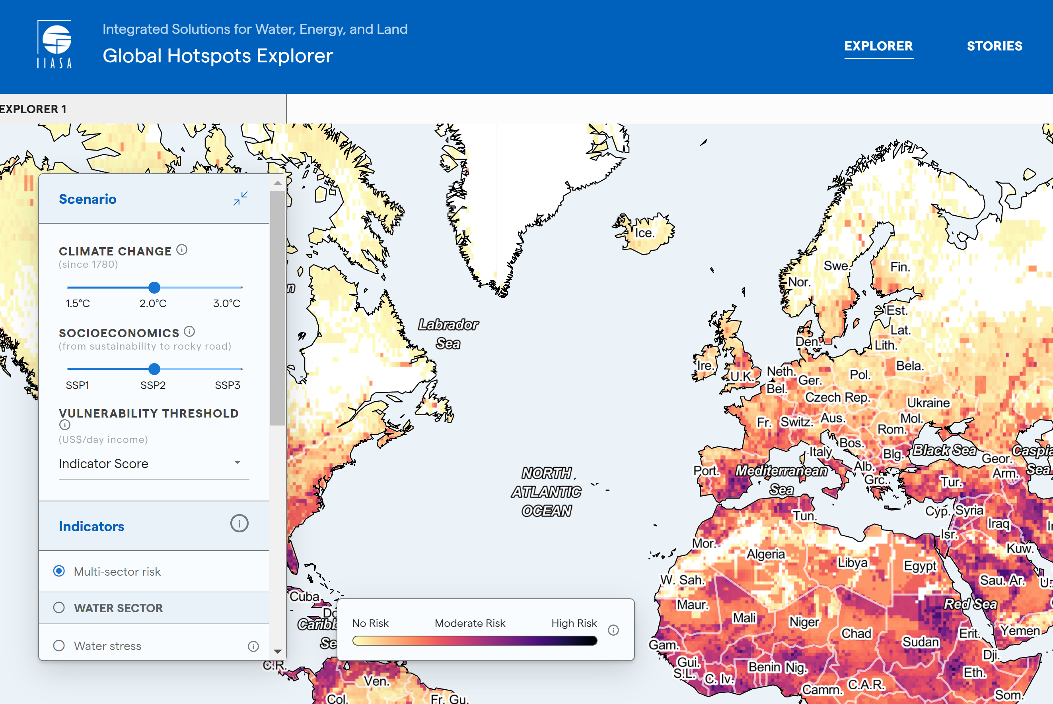
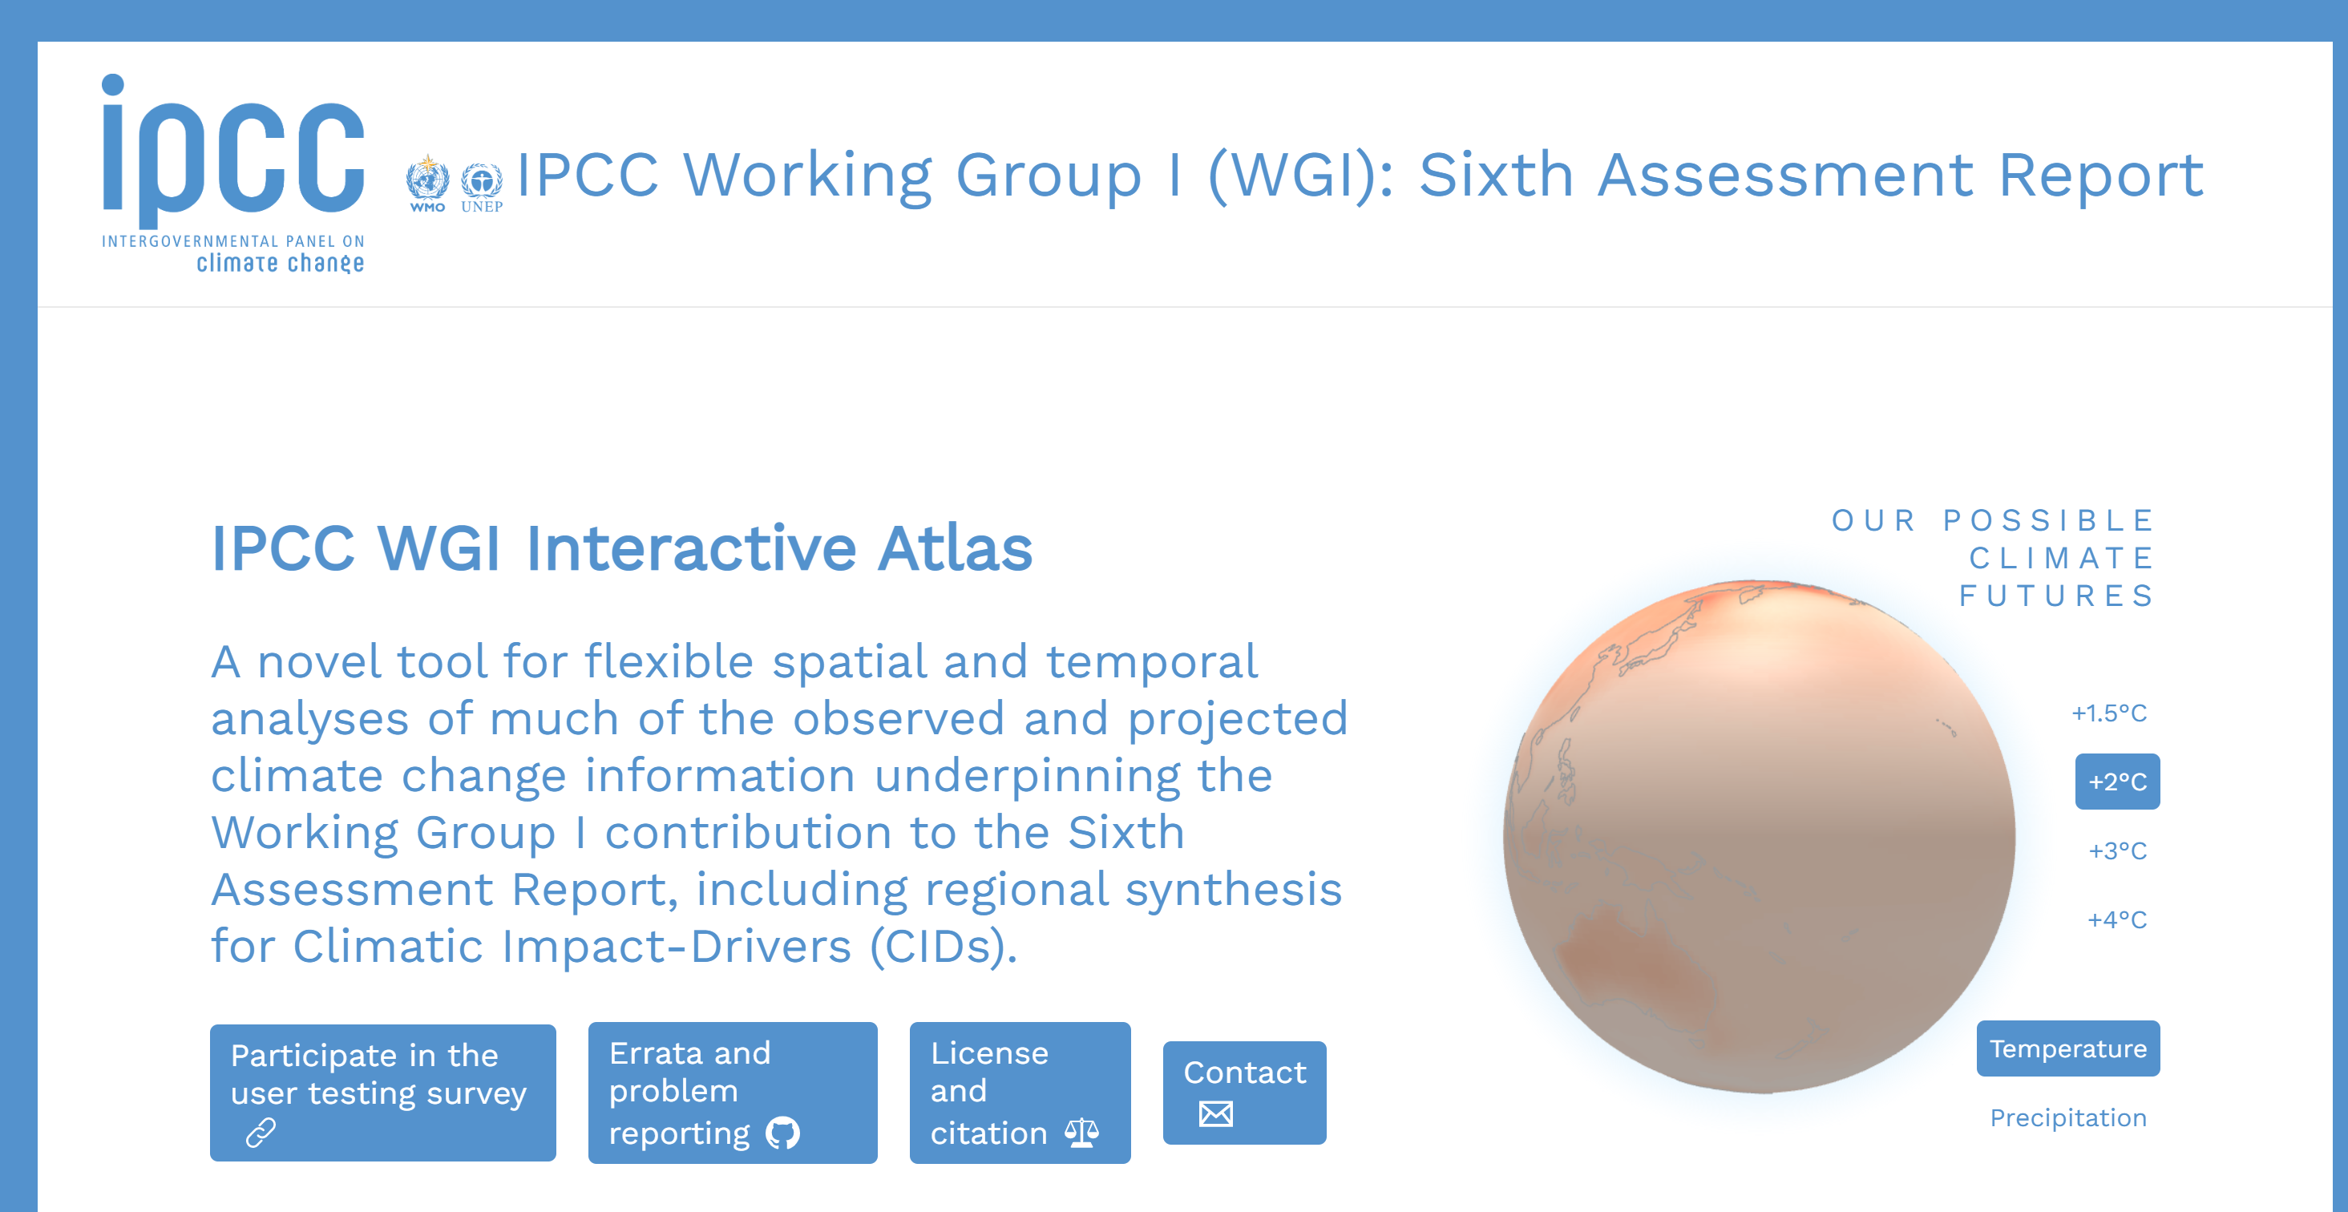
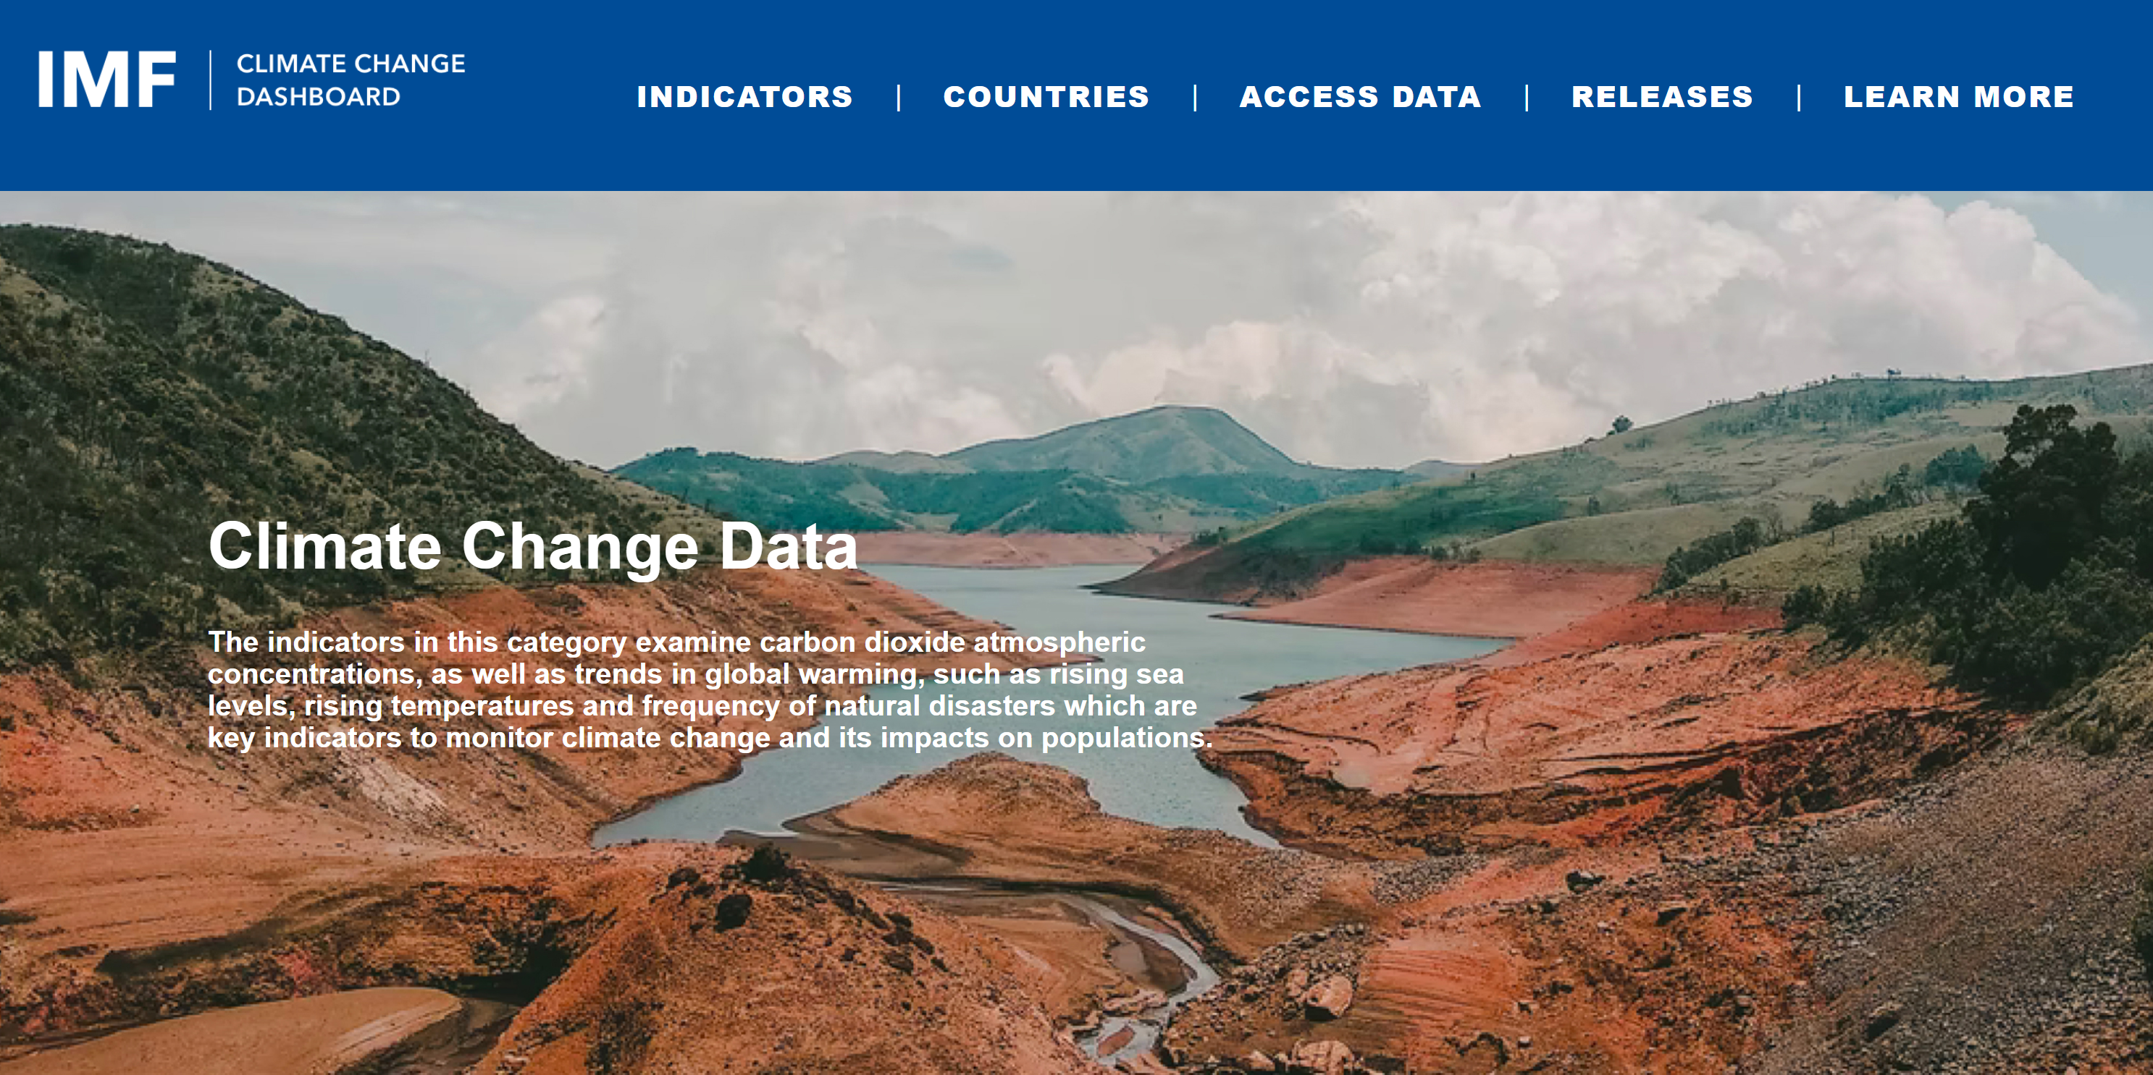
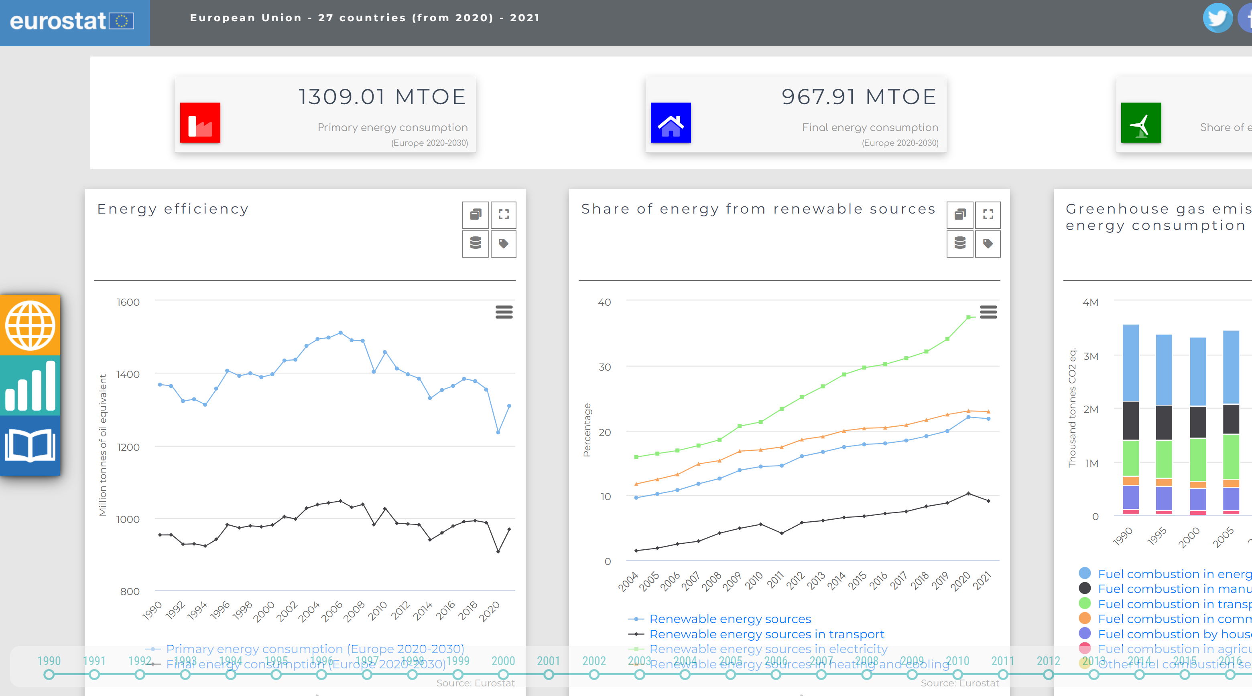
Motivation – Costs of not Dashboarding
Join at www.Slido.com #4138 202
WRI
WWF
Stranded insights and redundant work
Difficulty communicating complex & interrelated data
Limited ability to track indicators and trends
Reduced collaboration & exchange of knowledge
Limited Capacity for informed decision-making
Limited Visibility
IIASA
IPCC
IMF
Eurostat
Notes:
A lot of institutions are making dashboard. It's possible that you only know those institutions because of their dashboard (WRI for me, IIASA for other due to AR6, 1.5c, SSP dbs). Doesn't mean if they are doing it we should also do it. BUT there is a cost we have to pay for now having dashboards. The points are similar to the ones I talked about earlier.

Slide 11
Scope

Slide 12
slido
Who do you think is our potential audience?
ⓘ Start presenting to display the poll results on this slide.

Slide 13
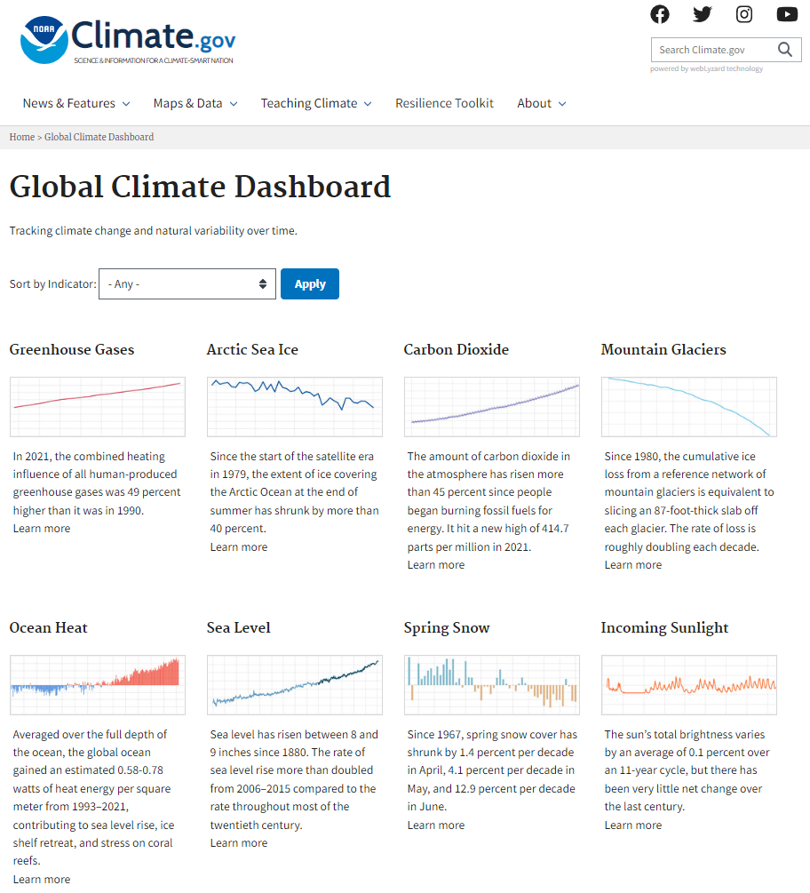
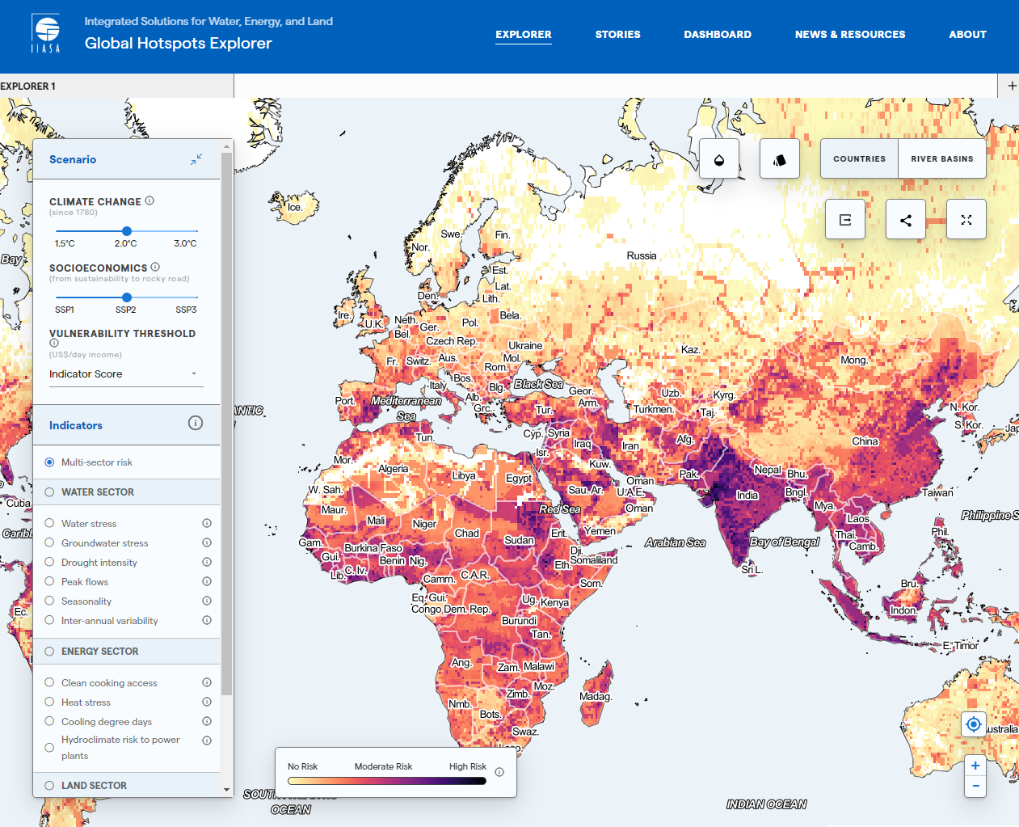
Scope: Audience
Join at www.Slido.com #4138 202
What information we show and How we show it will depend on the audience
https://www.climate.gov/climatedashboard
IIASA Hotspot Explorer

Slide 14
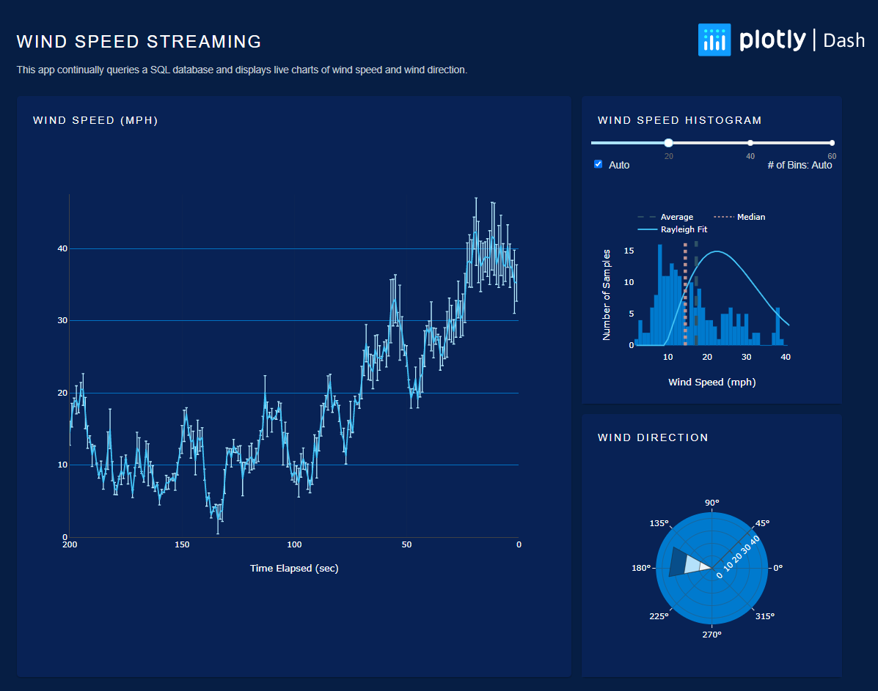
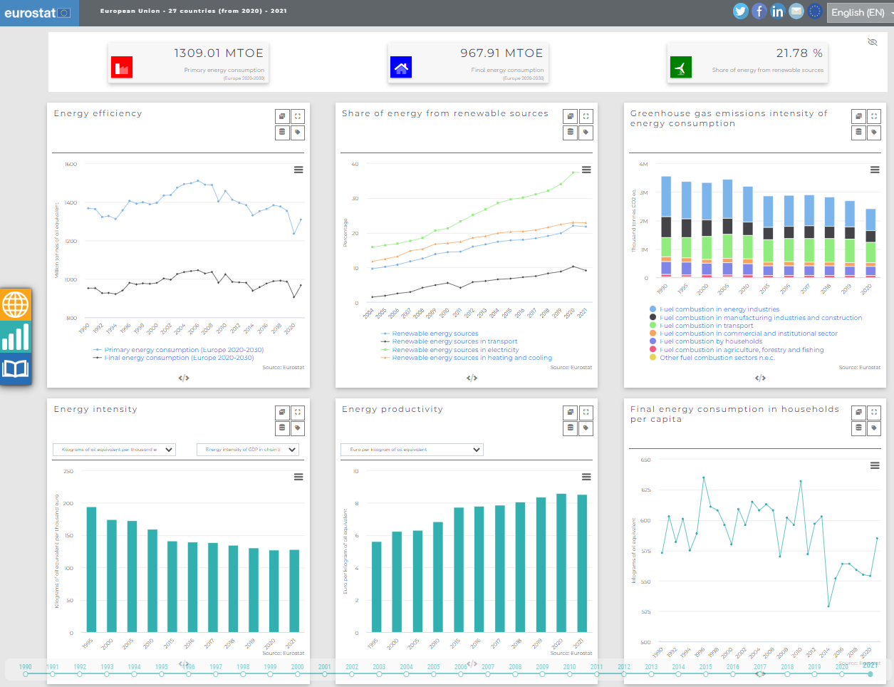
Scope: Audience
Join at www.Slido.com #4138 202
What information we show and How we show it will depend on the audience
https://dash.gallery/dash-wind-streaming/
https://ec.europa.eu/eurostat/cache/infographs/energy_dashboard/endash.html

Slide 15
What insights would you want to show in a dashboard?
ⓘ Start presenting to display the poll results on this slide.

Slide 16
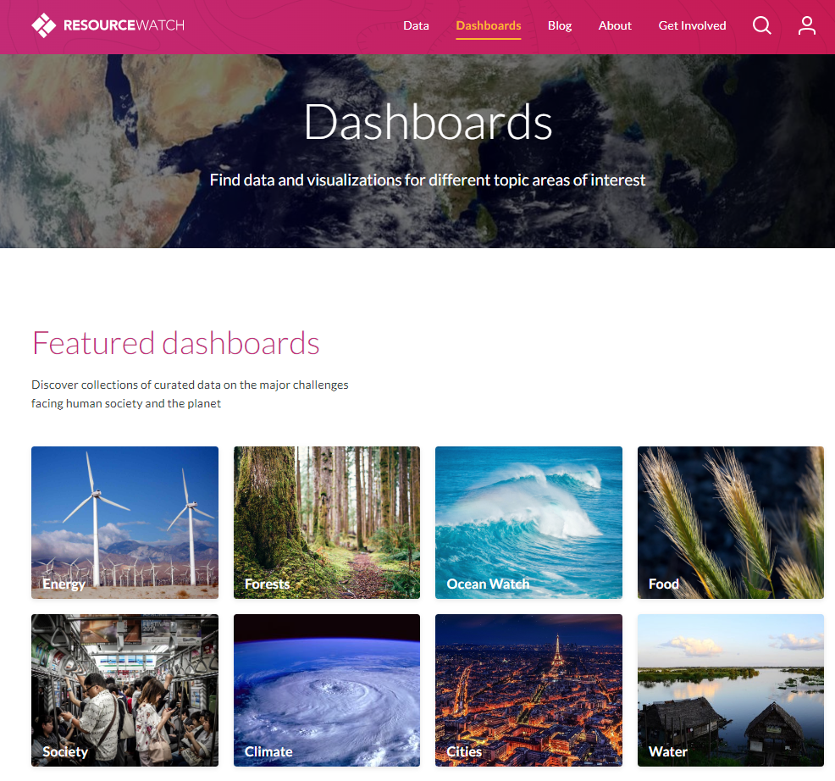
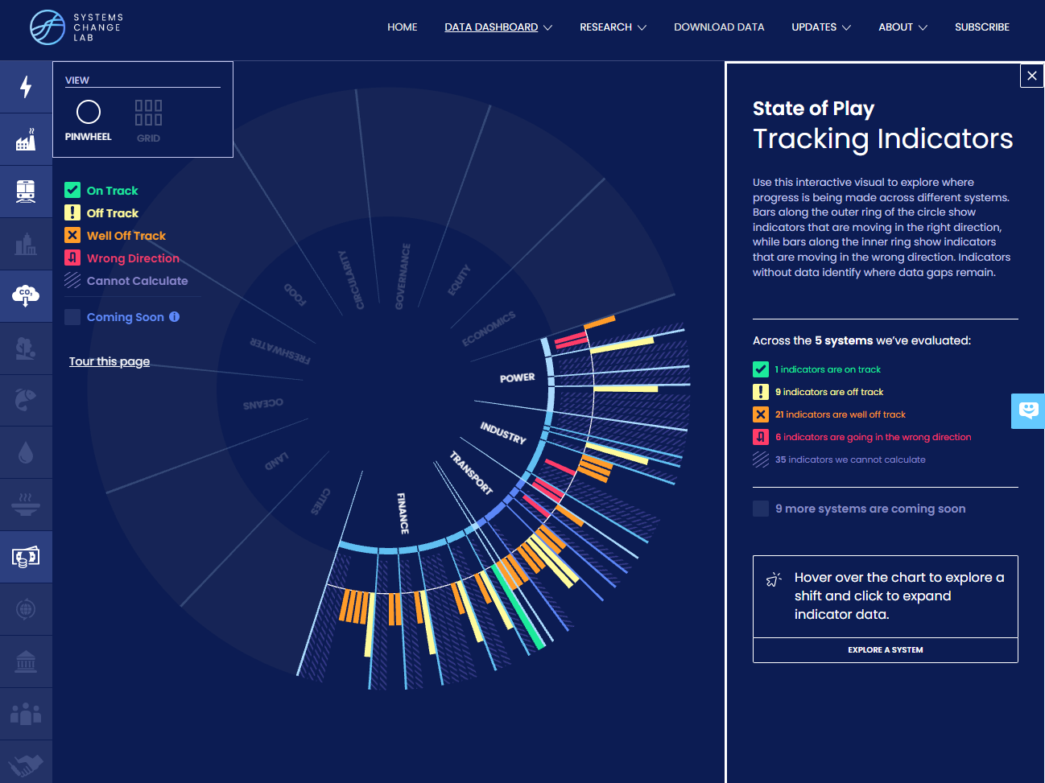
Scope: Sectoral vs Multi-sector
Join at www.Slido.com #4138 202
Sectoral Dashboards
Multi-sector Dashboard
https://systemschangelab.org/dashboard
https://resourcewatch.org/dashboards

Slide 17

Do you think we need several Sectoral dashboards or one Multi-Sector dashboard?
ⓘ Start presenting to display the poll results on this slide.

Slide 18
Design

Slide 19
Design: Dashboard Elements
Join at www.Slido.com #4138 202
Content
Relevant
Digestible
Layout
Grouped data
White Space
Color
Sparingly
Deliberately
Flat UI
Accessibility
Fonts
Consistent
Max 3 sizes
Visualizations
Chart choices
Placement
Cross-filtering
Responsiveness
Multiple OS
Multiple devices
Screen sizes
Data
Availability
Transparency
https://www2.insightsoftware.com/dashboard-design-guide/dashboard-design-fundamentals/

Slide 20
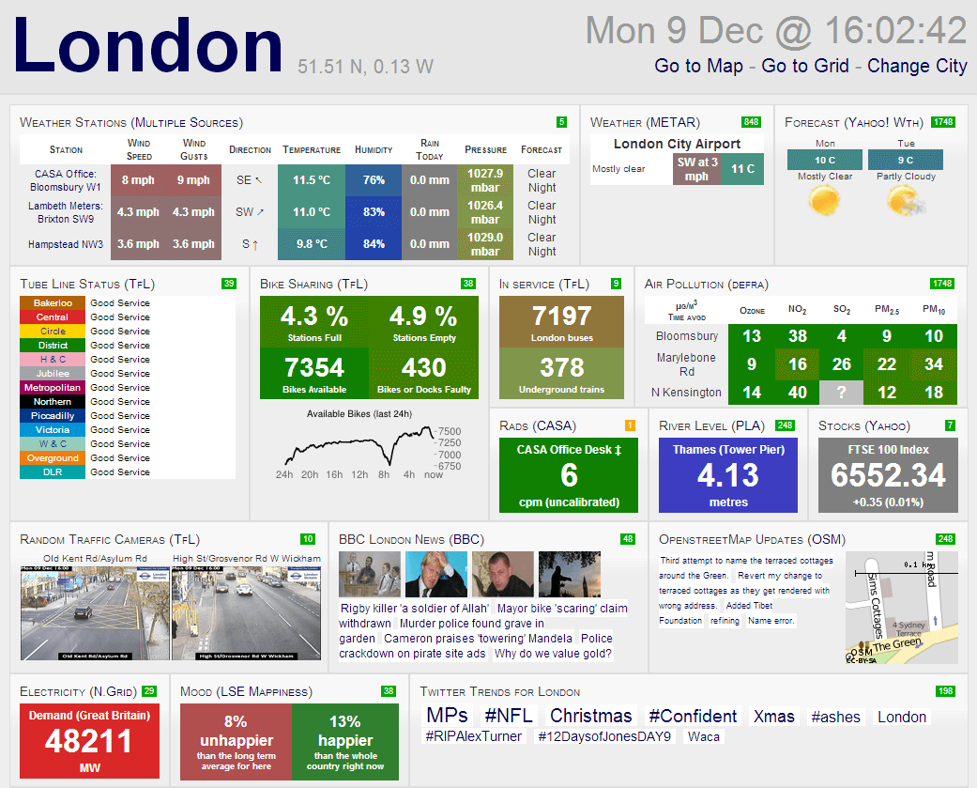
Survey: What stands out to you about this dashboard?
Join at www.Slido.com #4138 202

Slide 21
Design: Dashboard mistakes to avoid
Too much information
Too many different types of visualizations
Too many colors
Too busy
Lack of Focus
Lack of context
Poor data to viz pairing
Insufficient labels
https://databox.com/bad-dashboard-examples
https://citydashboard.org/london/

Slide 22
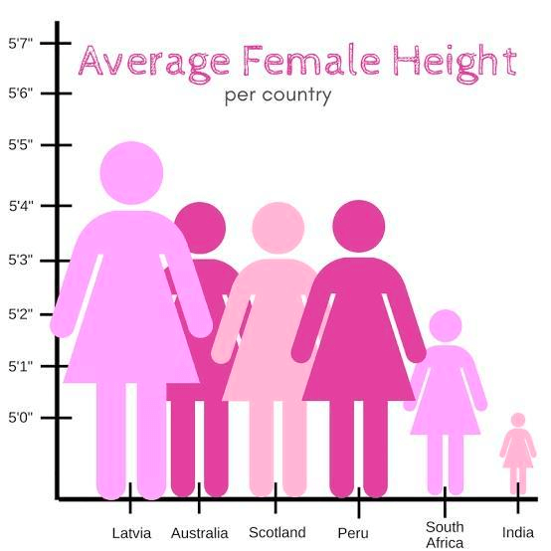
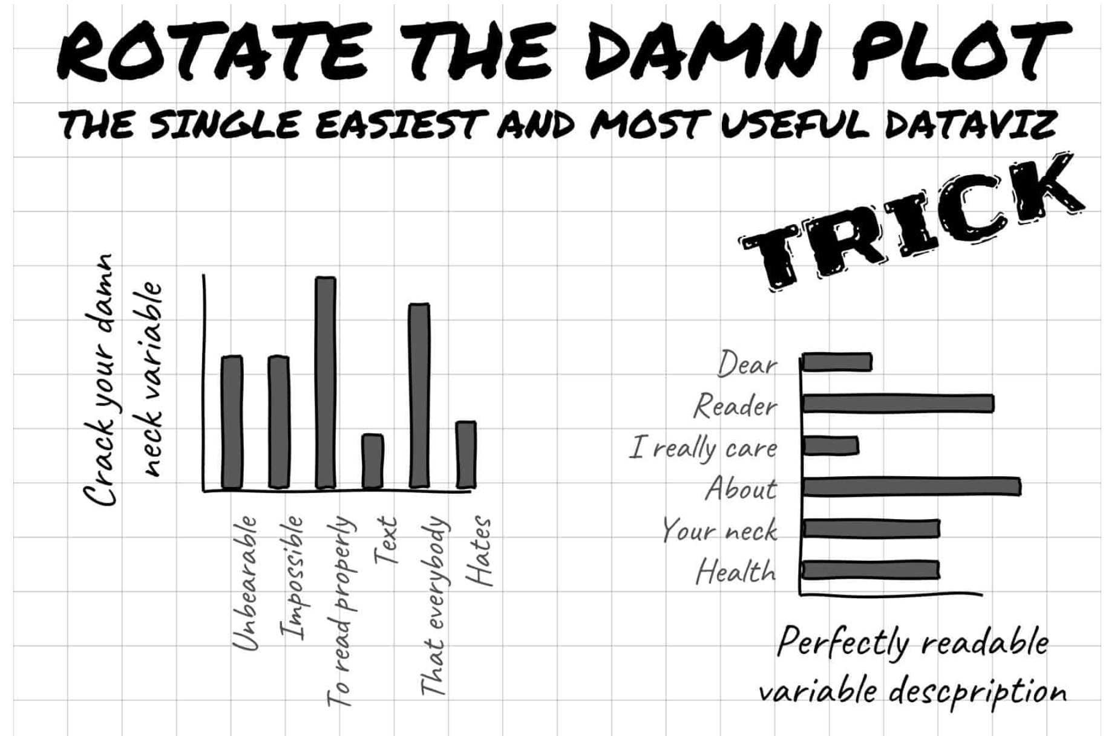
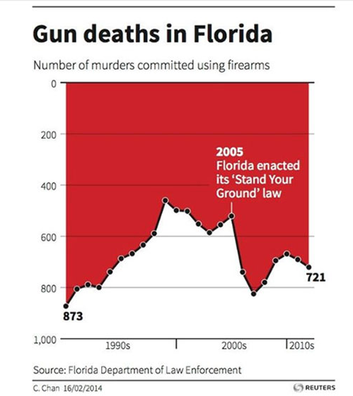
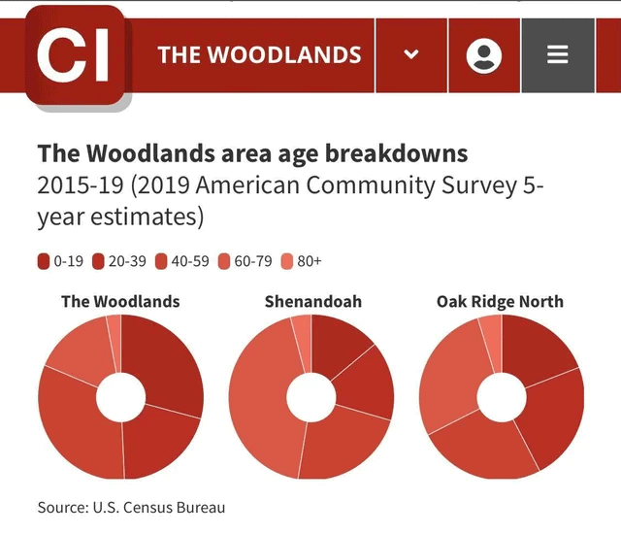
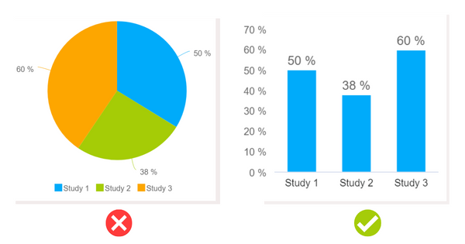
Design:Visualization mistakes to avoid
Cropped Y Axis
Readability
Misrepresenting Data
Color Scale Choices
Using inappropriate charts
Notes:
VIsualization examples: https://www.oldstreetsolutions.com/good-and-bad-data-visualization
- Viz examples: https://www.datapine.com/blog/misleading-data-visualization-examples/
- Viz Examples: https://ninjatables.com/bad-data-visualization-examples/
- Viz Examples: https://wpdatatables.com/misleading-data-visualization-examples/

Slide 23
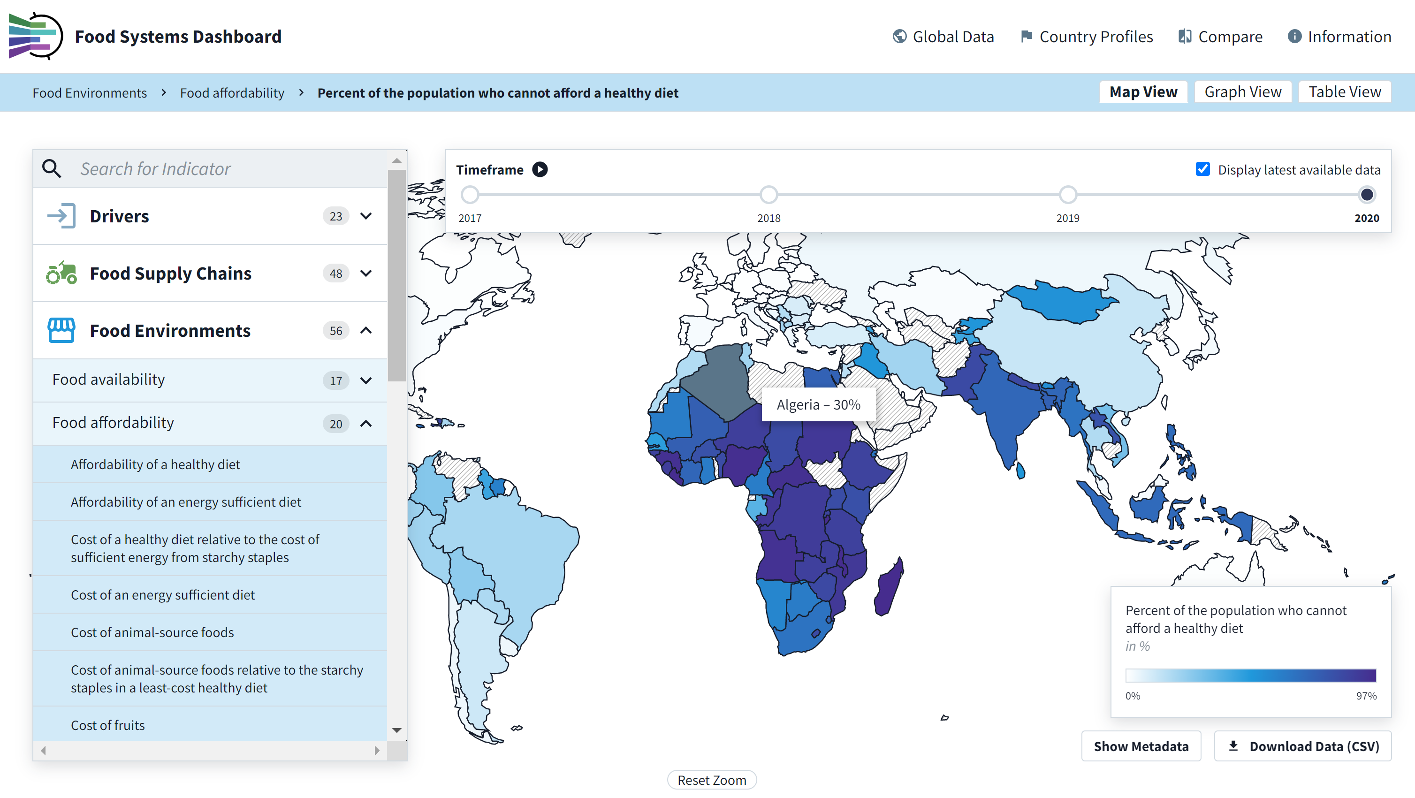
Survey: What stands out to you about this dashboard?
Join at www.Slido.com #4138 202

Slide 24
Design: Dashboard Example
Too much information (but organized?)
Too many different types of visualizations
Too many colors
Too busy
Lack of Focus
Lack of context
Poor data to viz pairing
Insufficient labels
https://www.foodsystemsdashboard.org/indicators/percent-of-the-population-who-cannot-afford-a-healthy-diet-at-52-percent-of-income-co-hd-headcount/map

Slide 25
Architecture

Slide 26
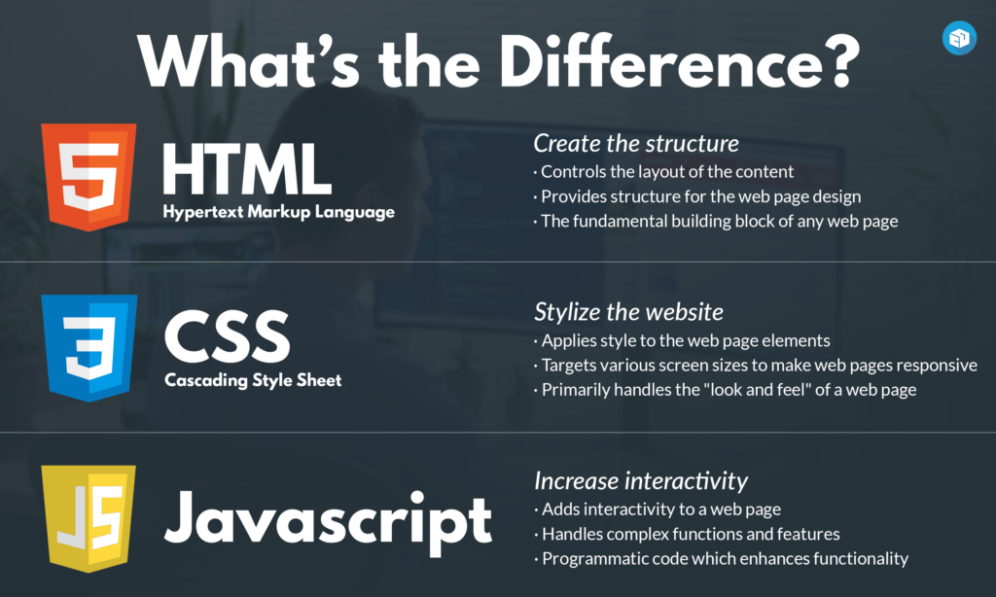
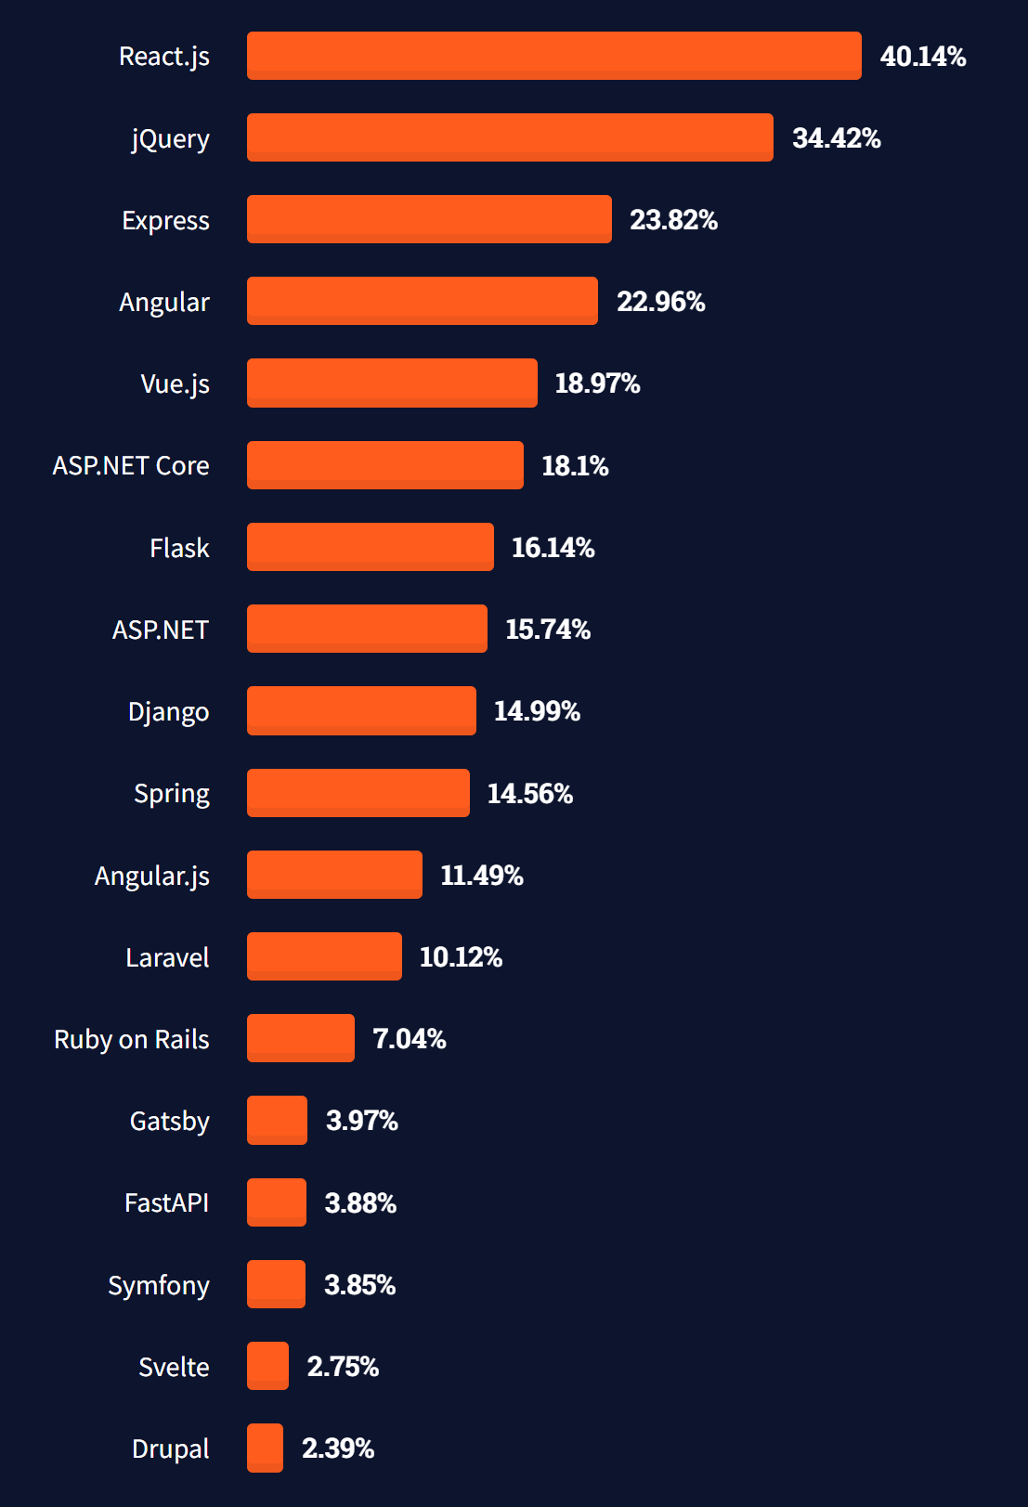


Architecture – Frontend - React
React
Stackoverflow
Most popular frontend frameworks
(67,593 responses)

Slide 27
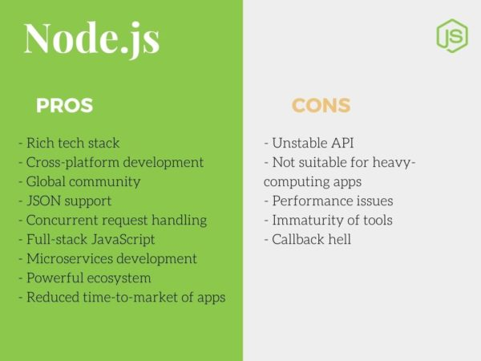
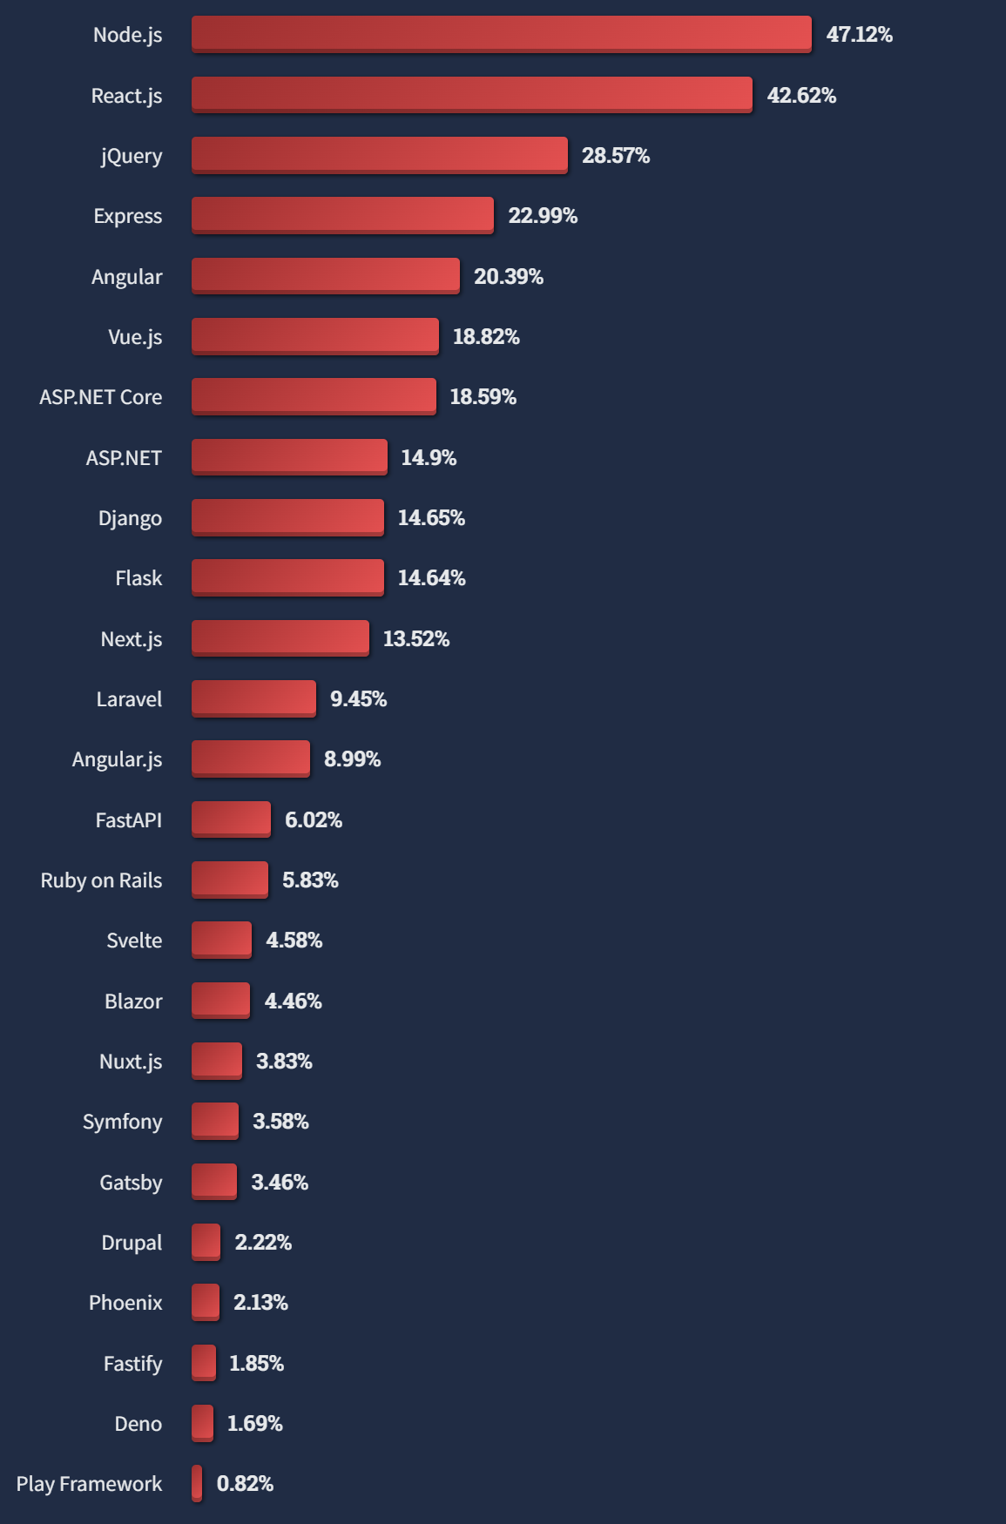

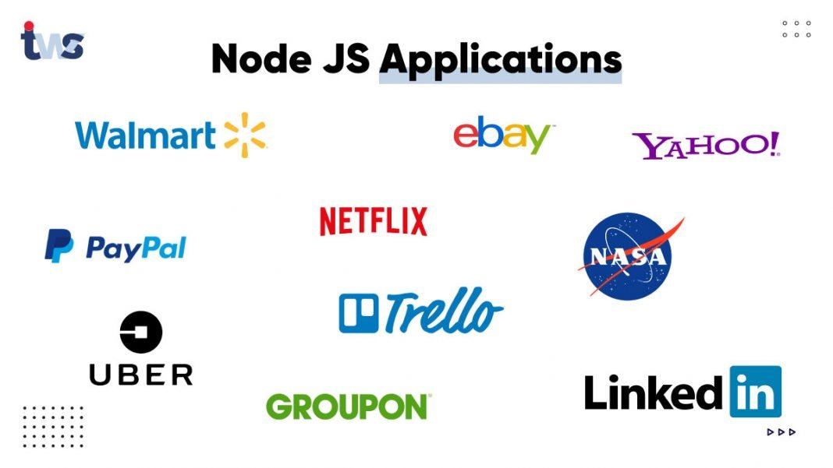
Architecture – Backend – Node JS
Stackoverflow
Most popular web technology
(58,723 responses)

Slide 28
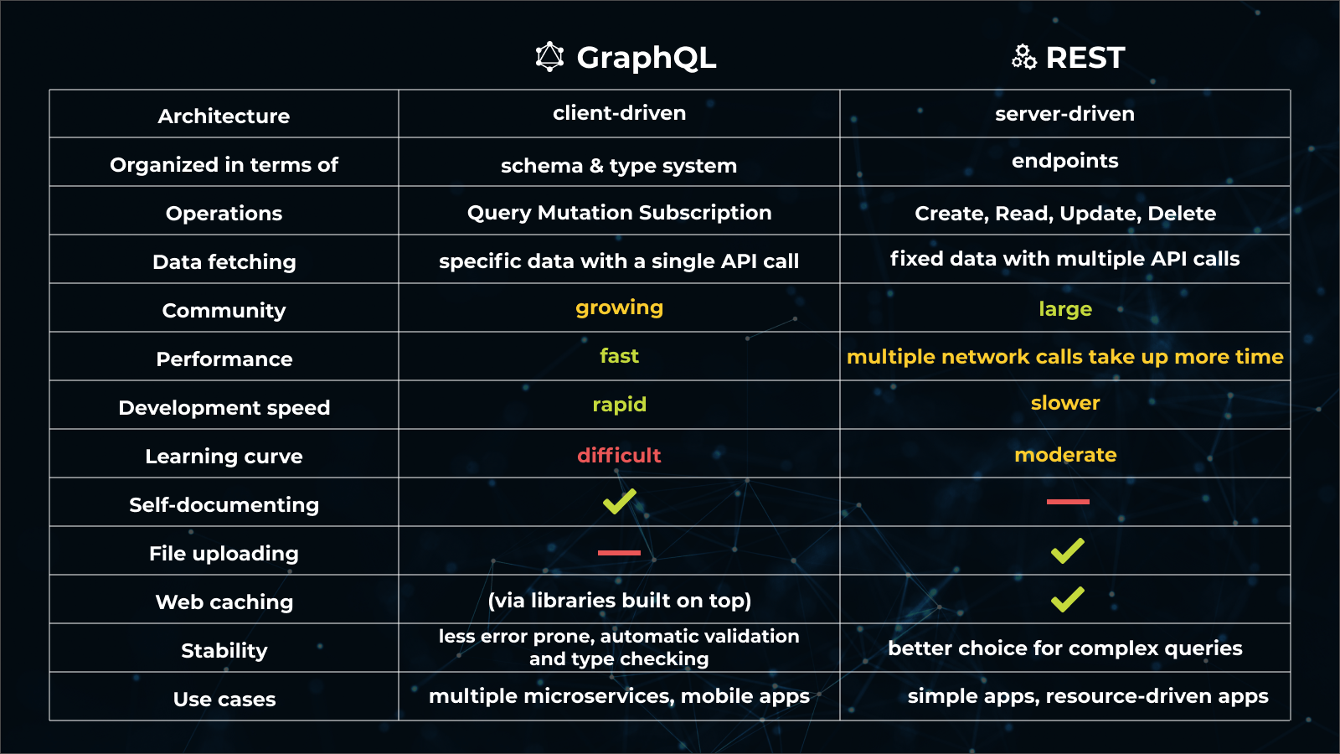

Architecture – Queries - GraphQL

Slide 29
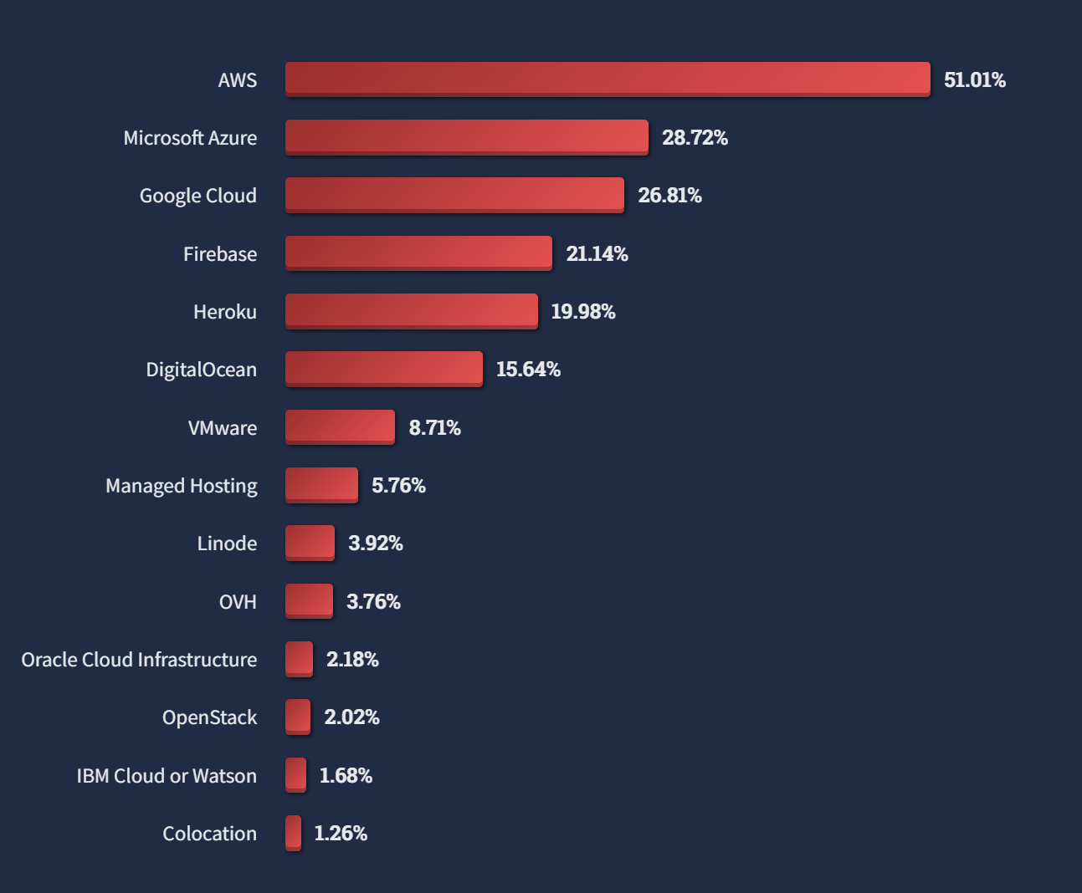
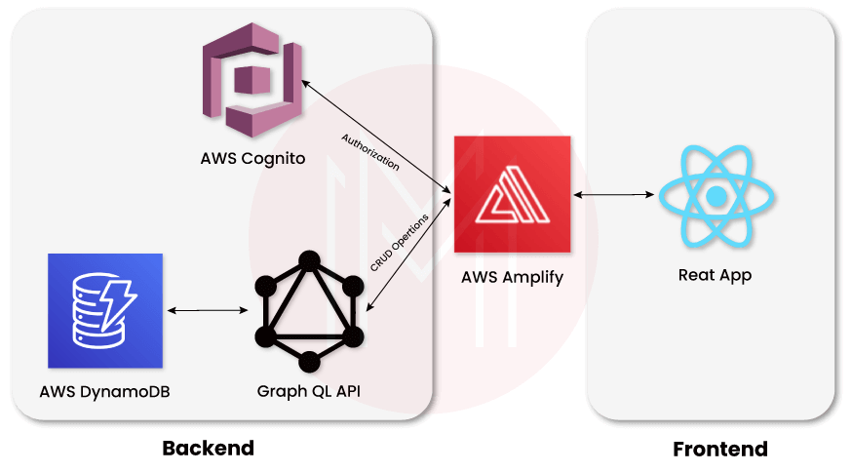
Architecture – Full Stack – AWS Amplify
Stackoverflow
Most popular cloud services
(56,533 responses)

Slide 30

Preview Foresight
https://aws.d1v6phfo3bkkj4.amplifyapp.com/

Slide 31
Open Ideas

Slide 32

Any other ideas or suggestions?
ⓘ Start presenting to display the poll results on this slide.

Slide 34
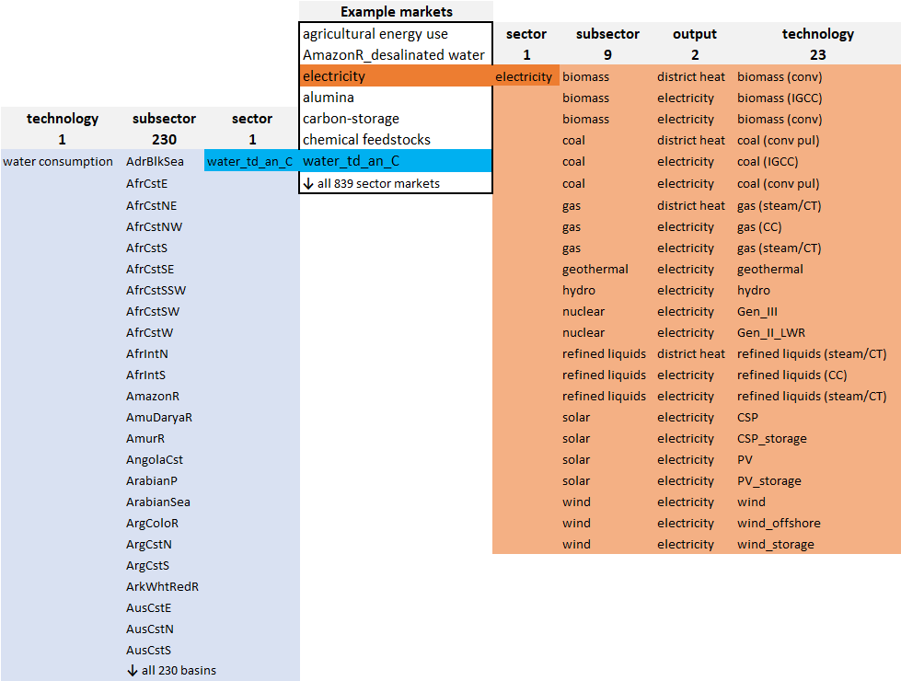
Appendix

